Slide 1
Introduction to Bioinformatics
In the name of the most high
Transcription
Ali Sharifi-Zarchi
Department of Computer Engineering, Sharif University of Technology
The contents including images and videos are from Bruce Alberts et al. Essential Cell Biology,
unless indicated separately.
These slides are available under the Creative Commons Attribution License.

Slide 2
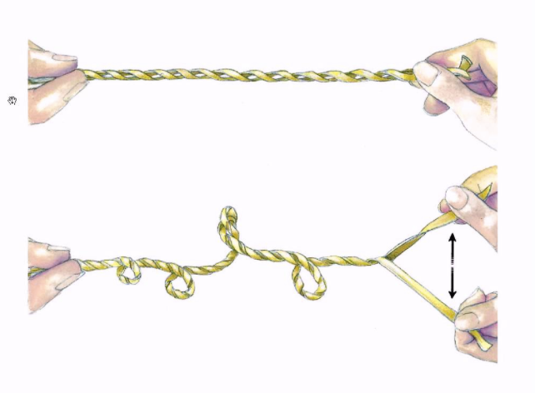
Questions from last session

Slide 3
Questions from last session

Slide 4
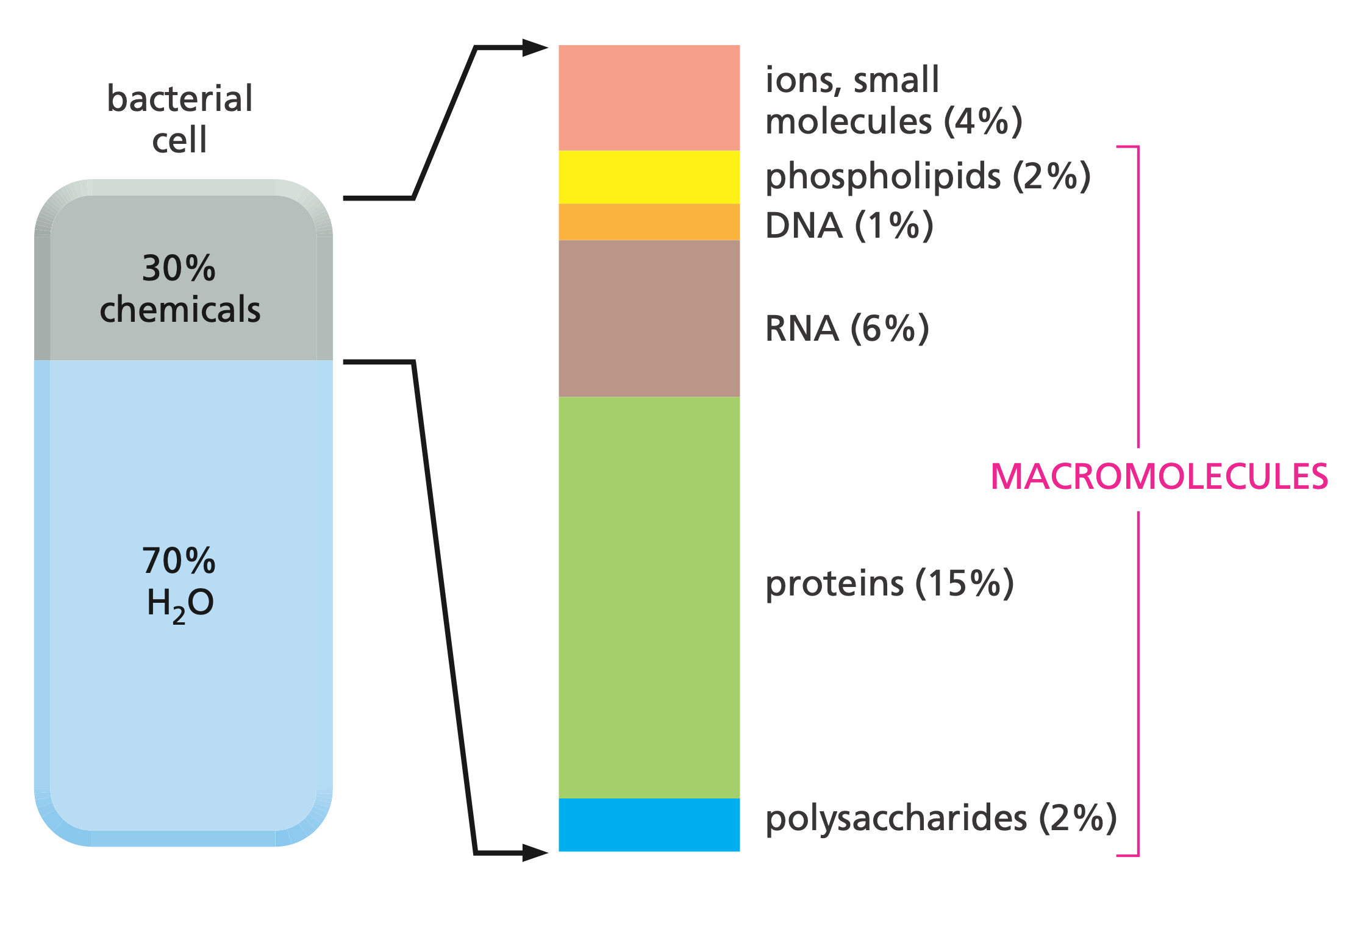
Abundant Macromolecules

Slide 5
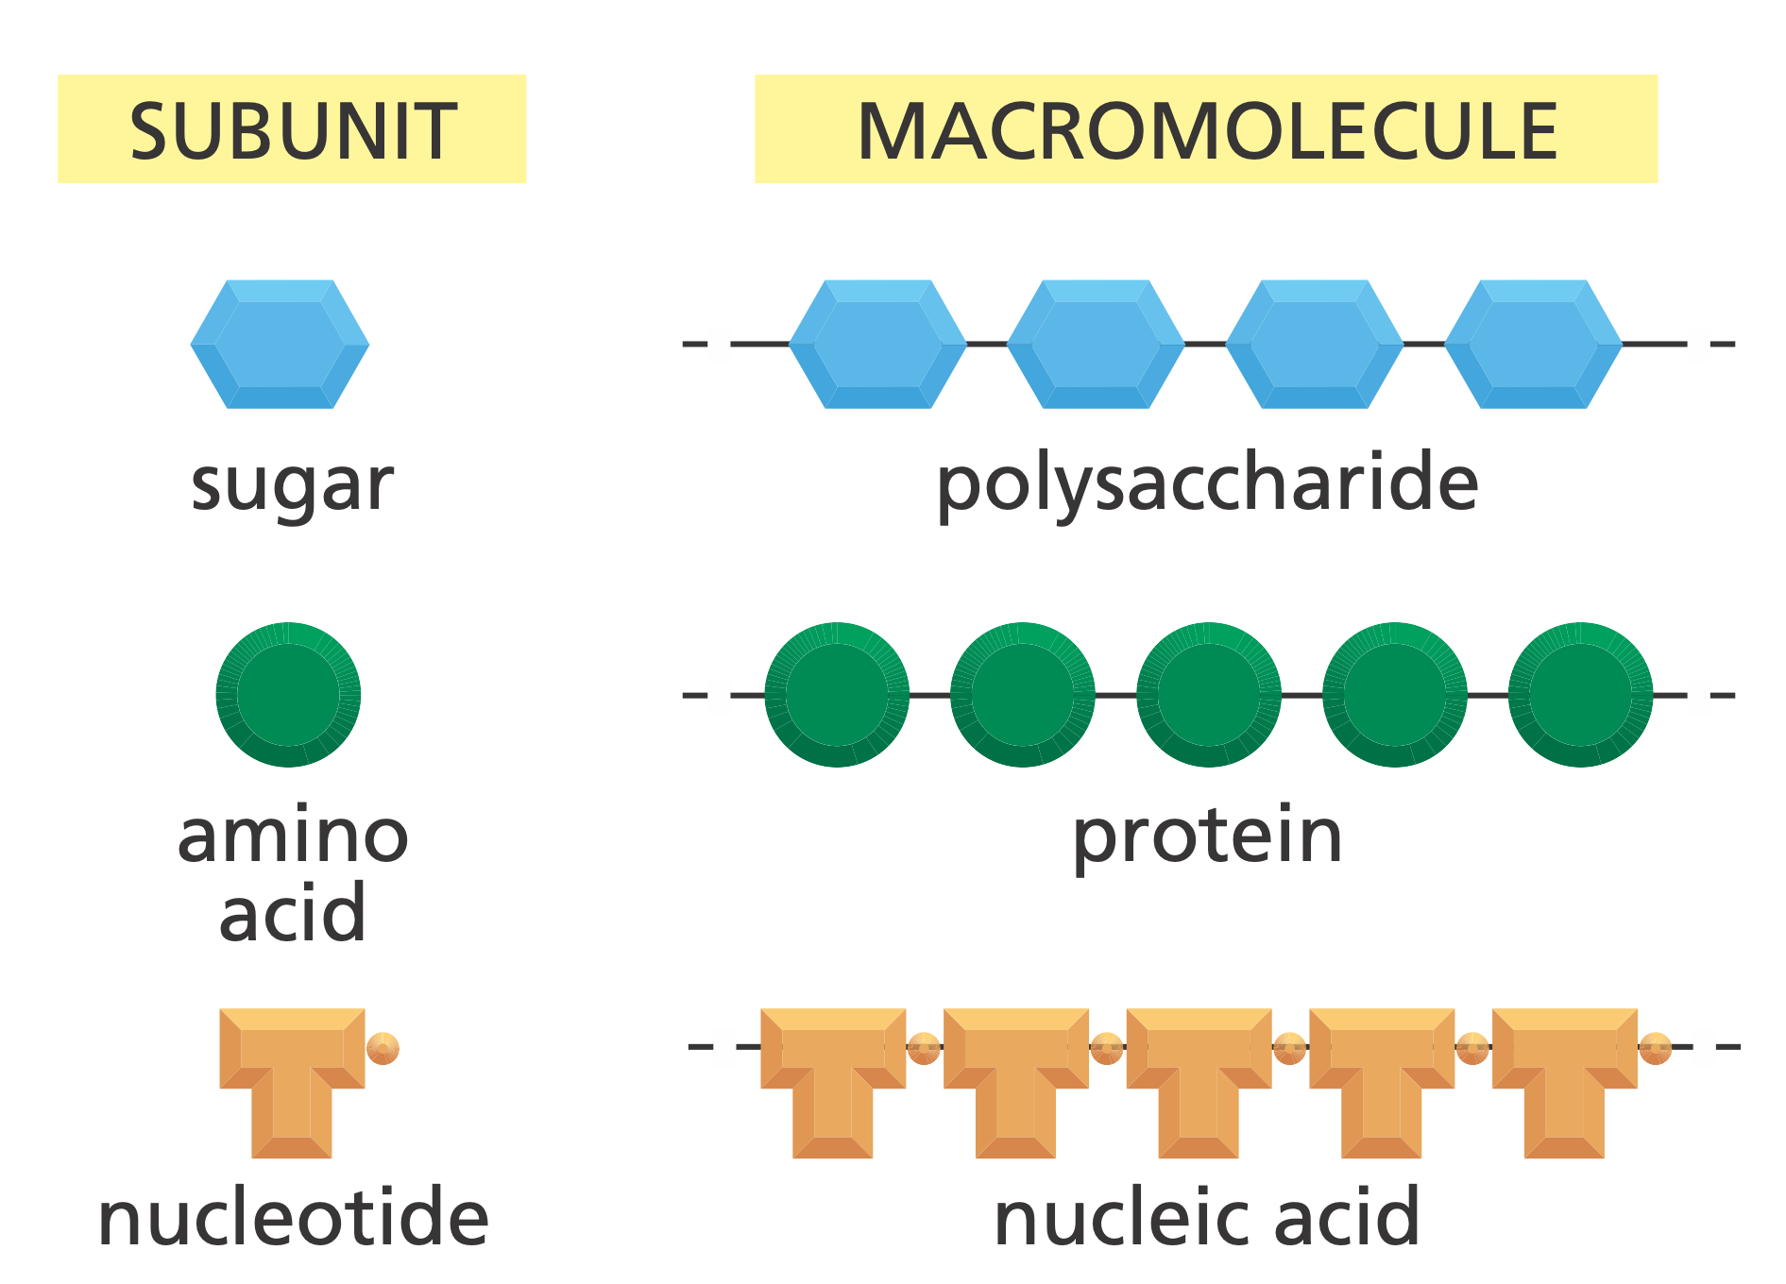
Macromolecules

Slide 6
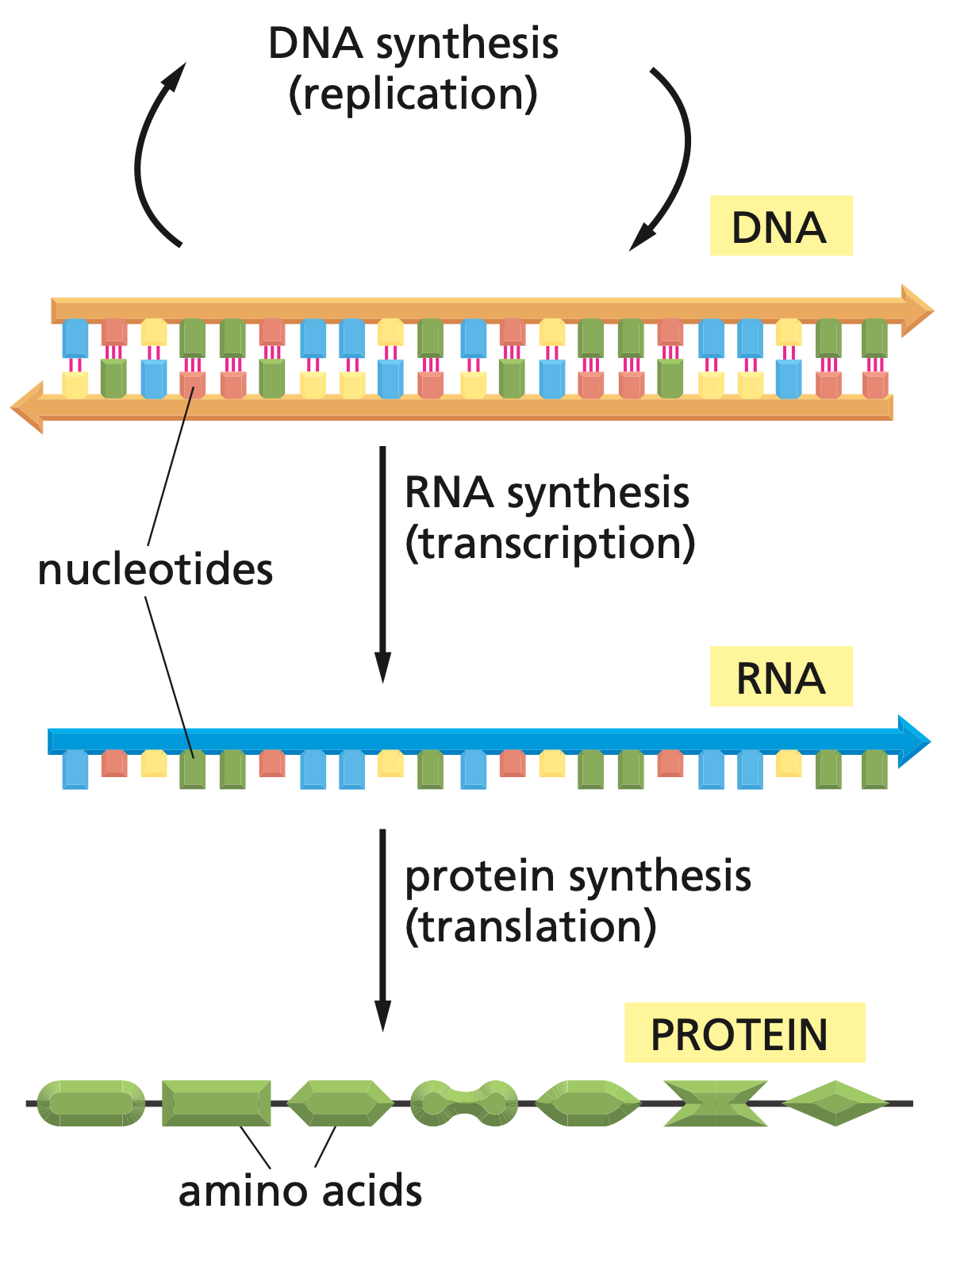
Central Dogma

Slide 7
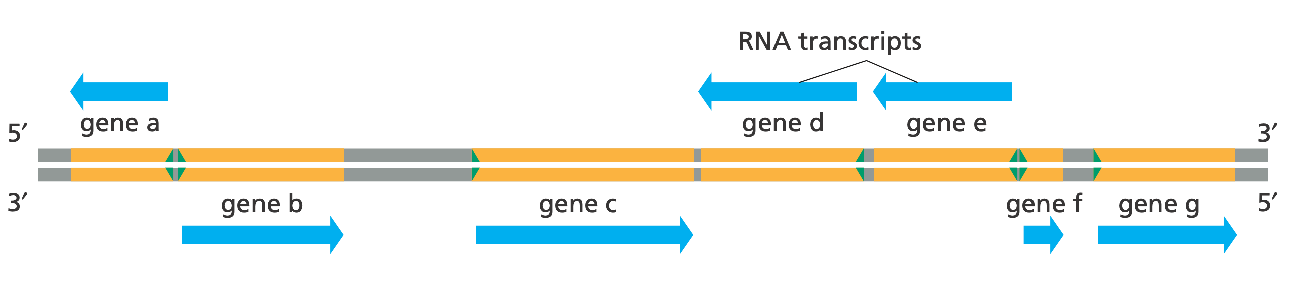
The Genes

Slide 8
RNA: The Messenger

Slide 9
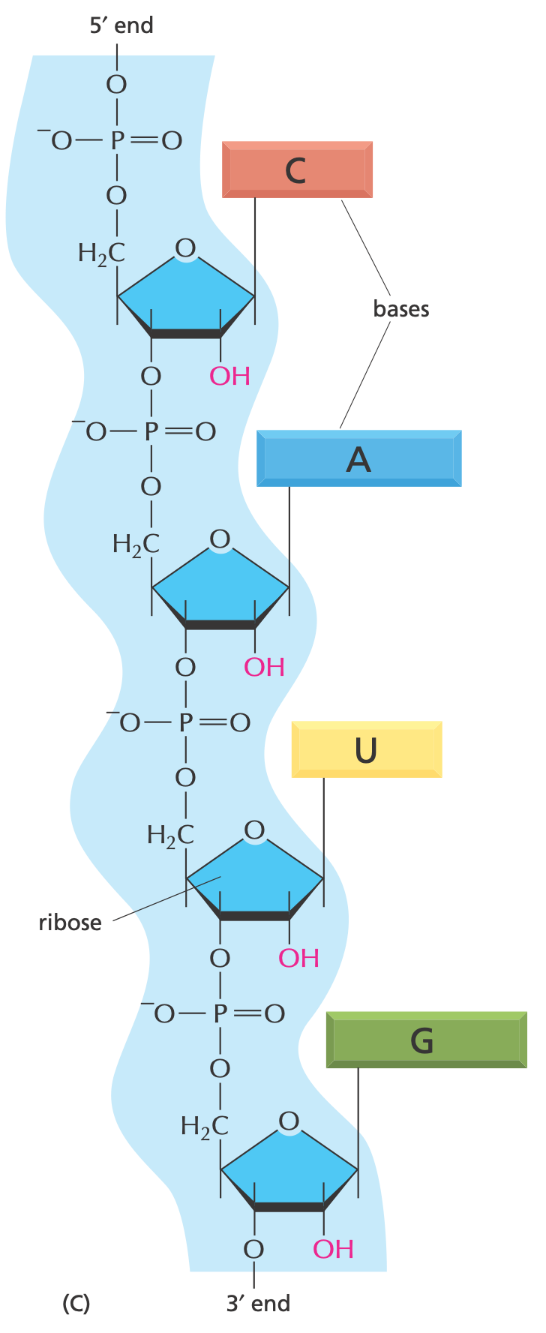
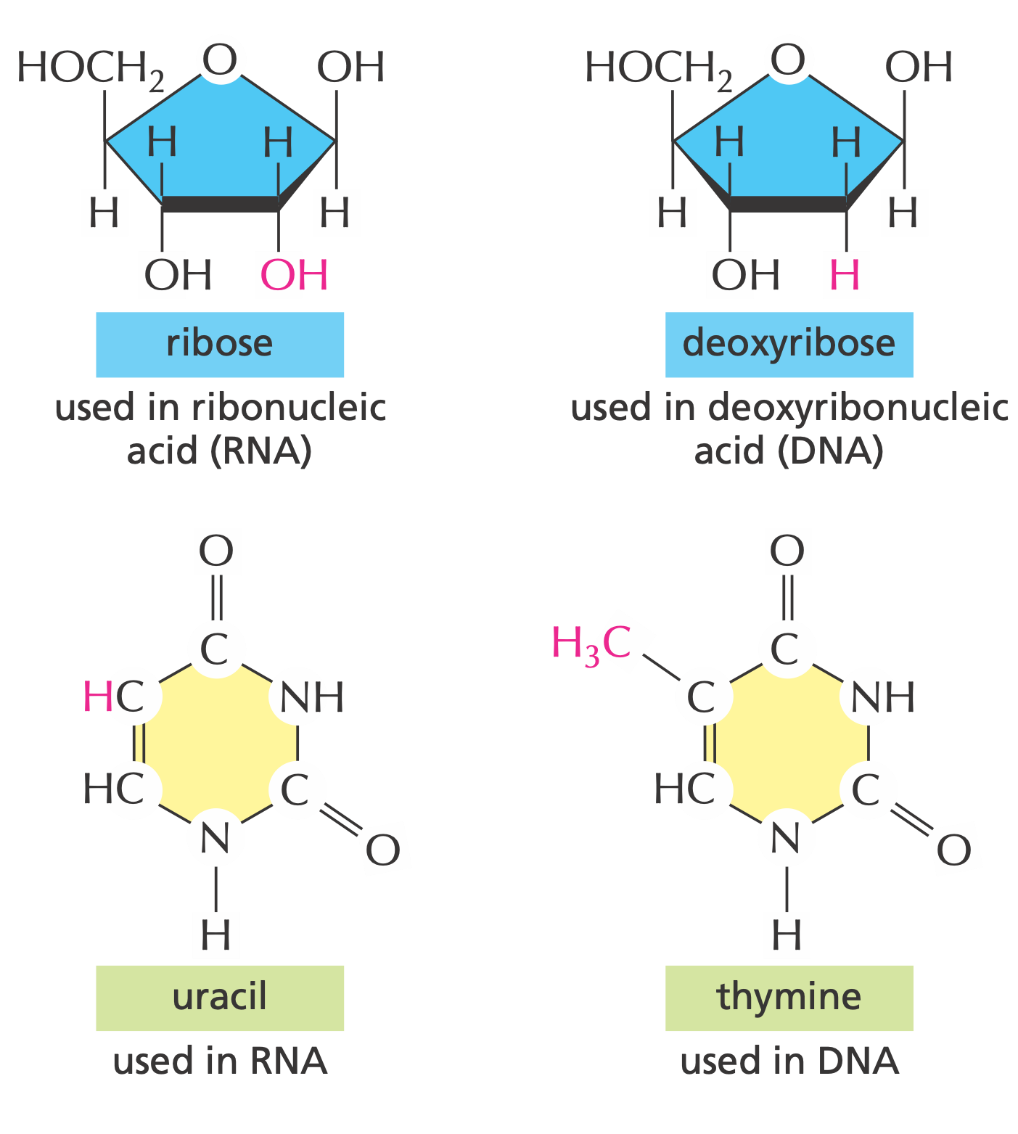
Chemical Structure of RNA

Slide 10
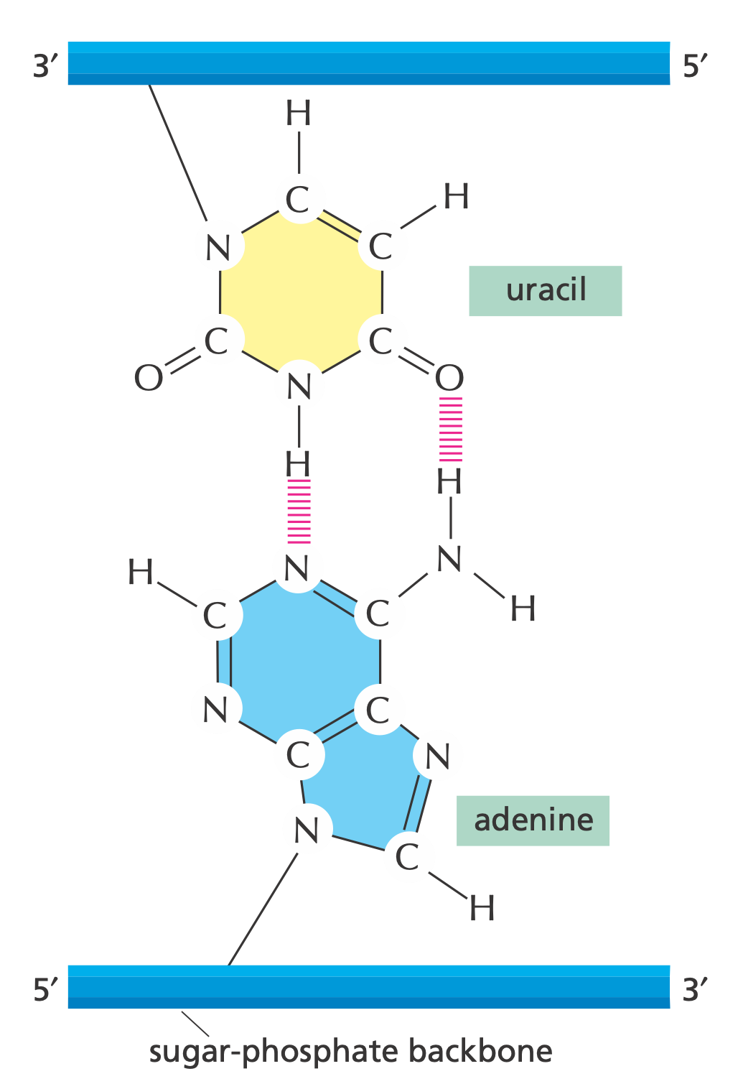
Uracil Bonding with Adenine

Slide 11
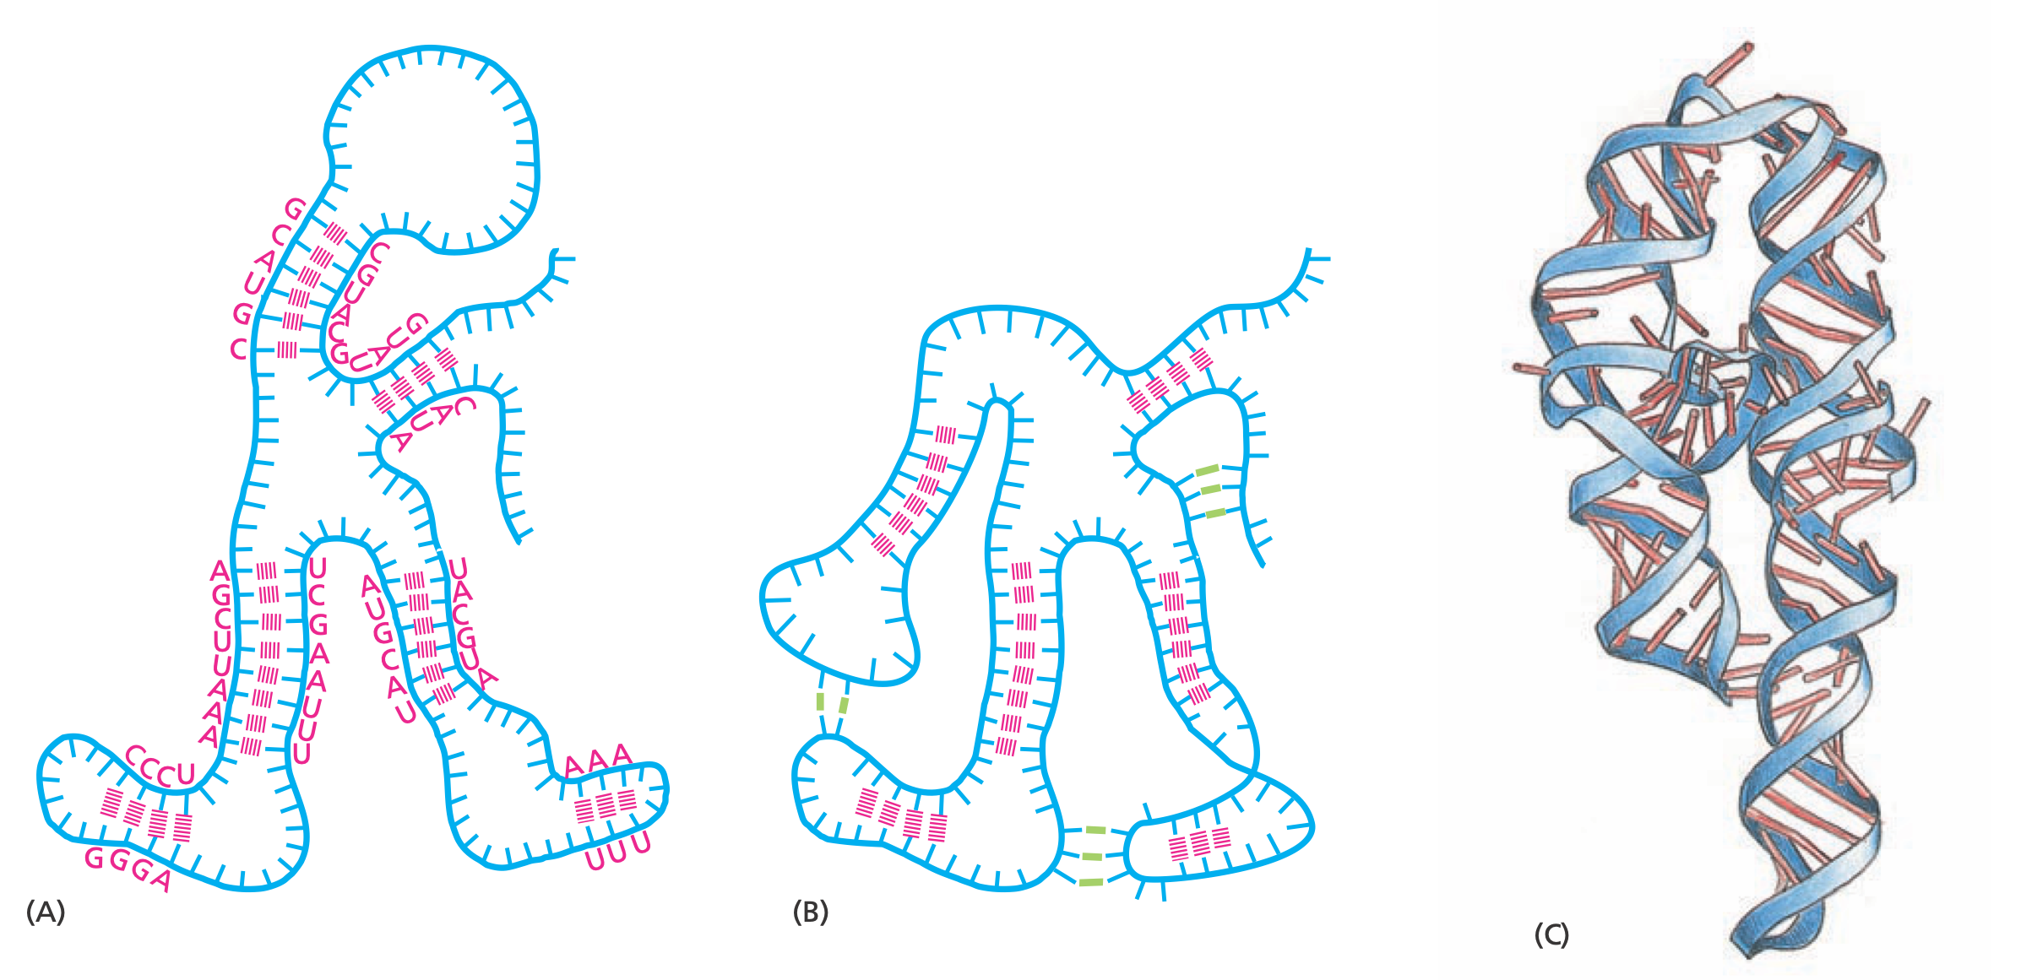
RNA Folding

Slide 12
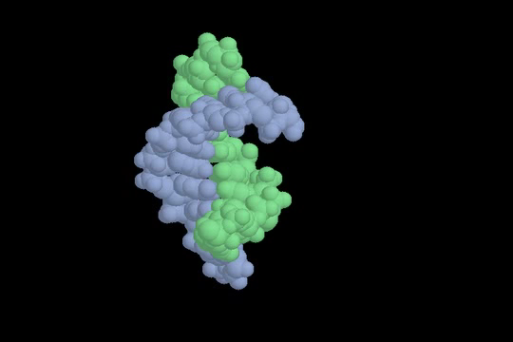
RNA Structure

Slide 13
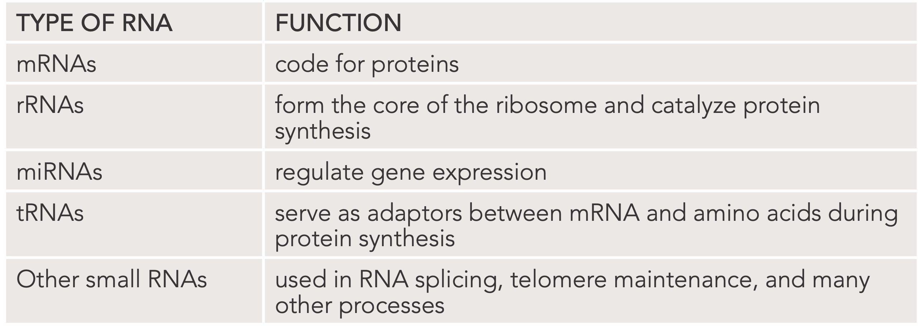
Types of RNA

Slide 14
Transcription:
Making RNA from DNA

Slide 15
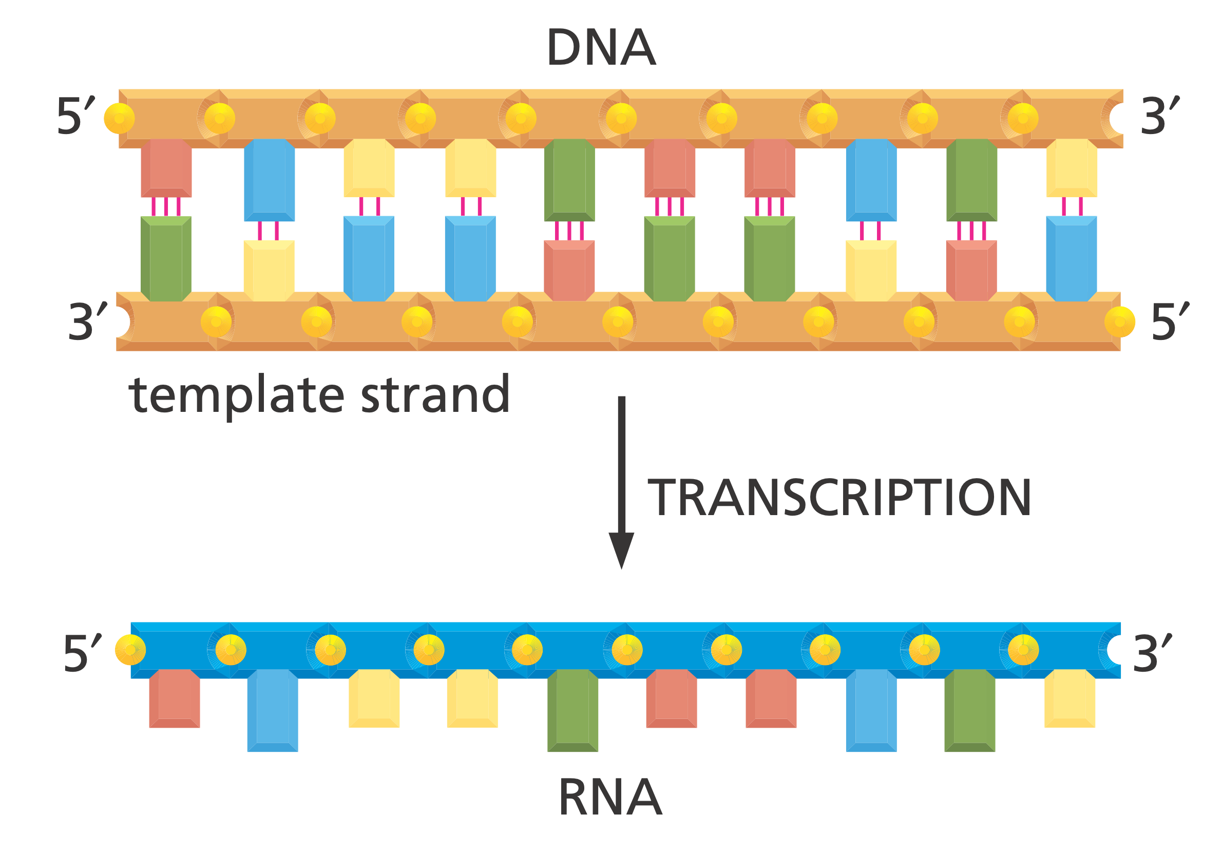
Transcription

Slide 16
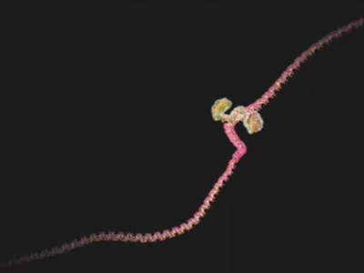
Transcription

Slide 17
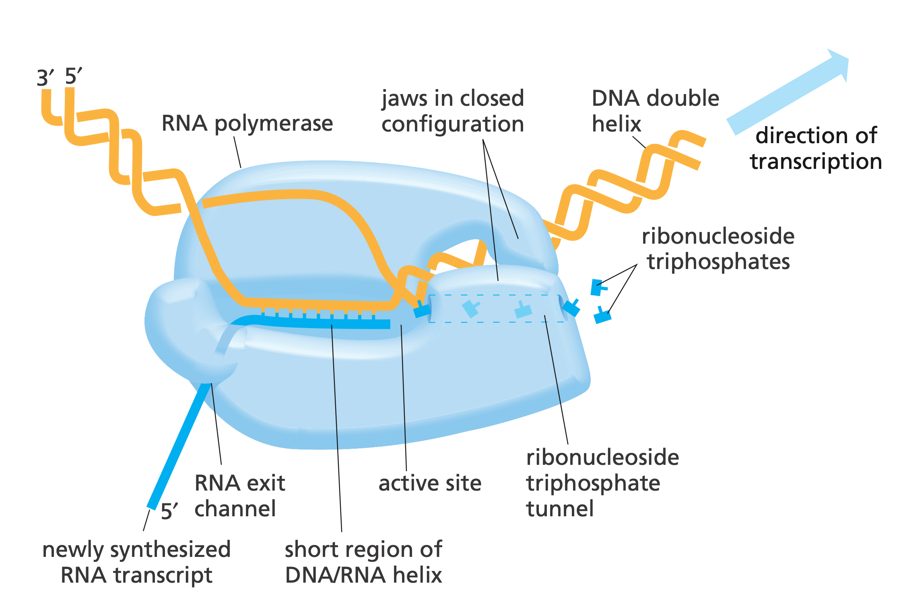
RNA-Polymerase

Slide 18
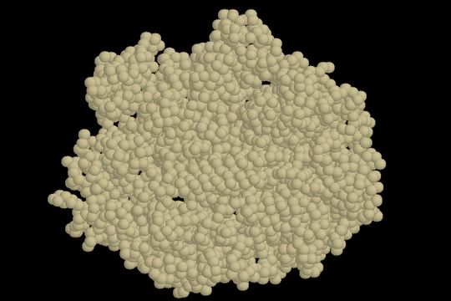
RNA-Polymerase

Slide 19
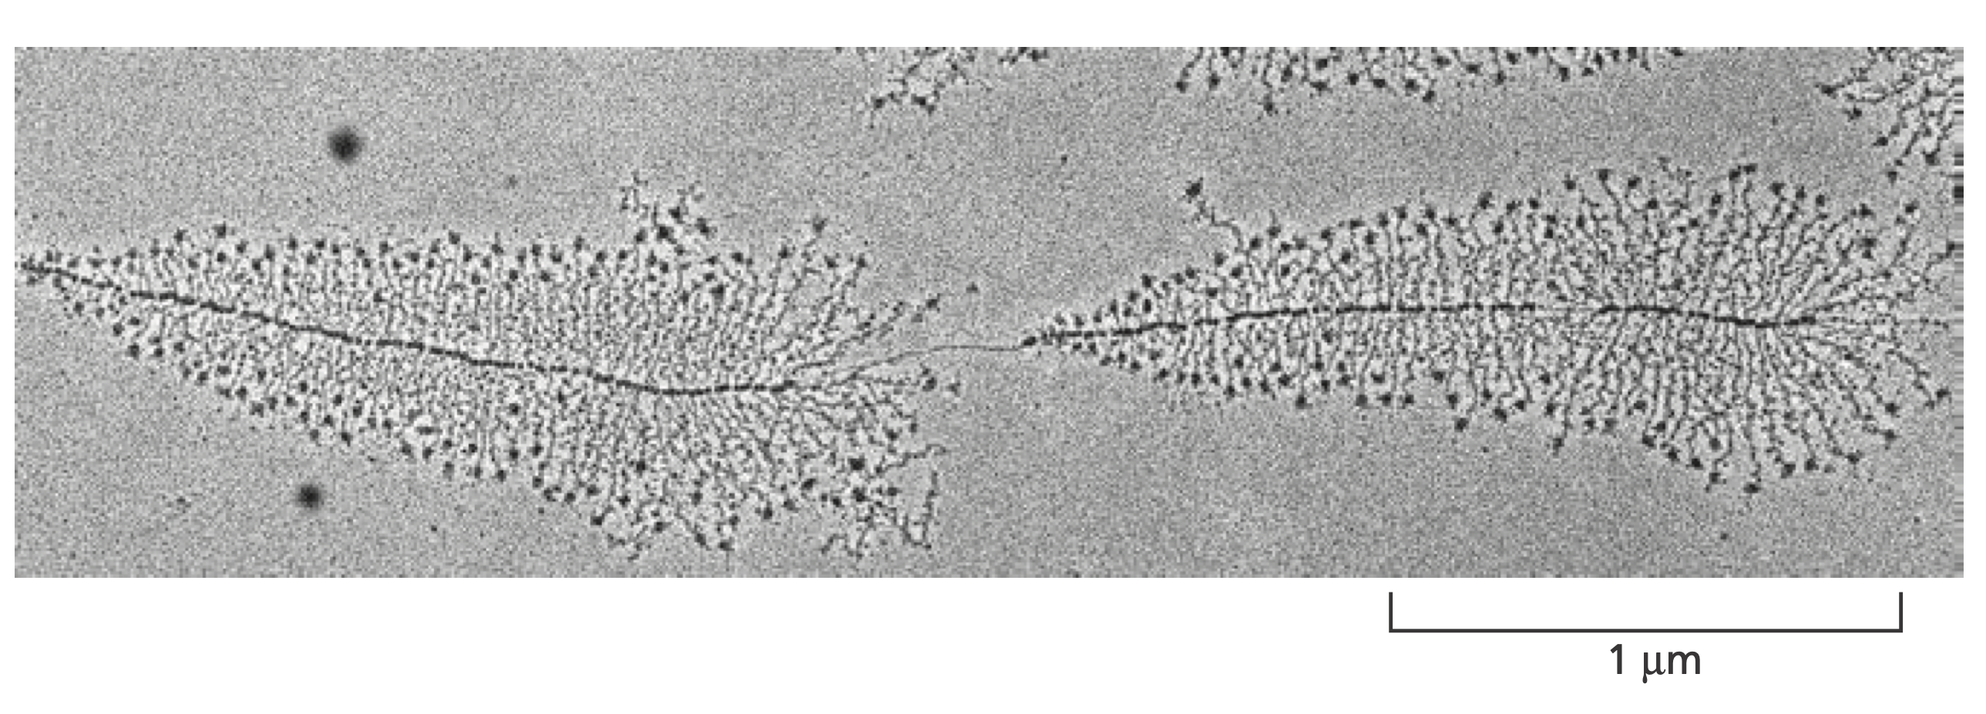
From One, Many

Slide 20
Both Directions

Slide 21
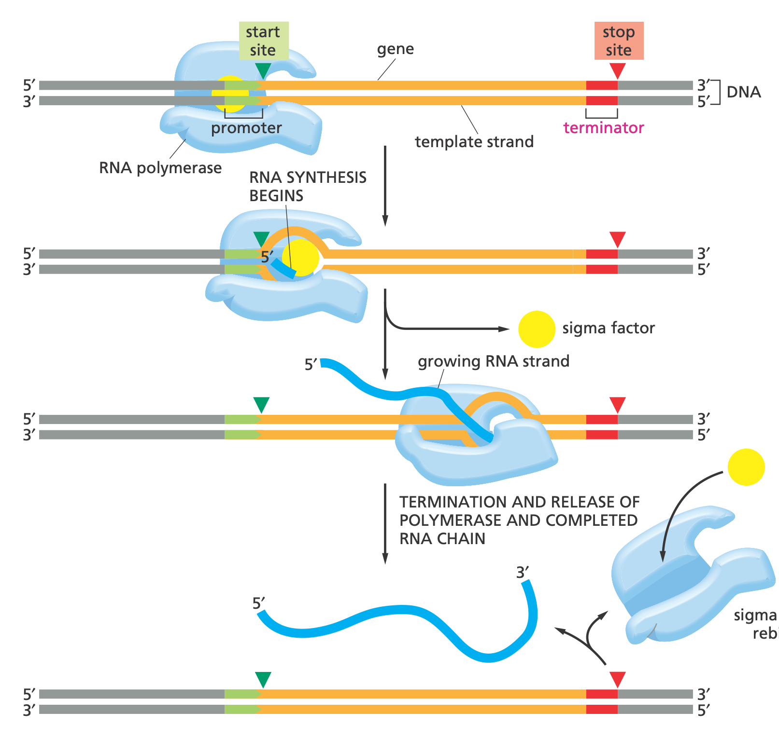

Prokaryotic Transcription

Slide 22
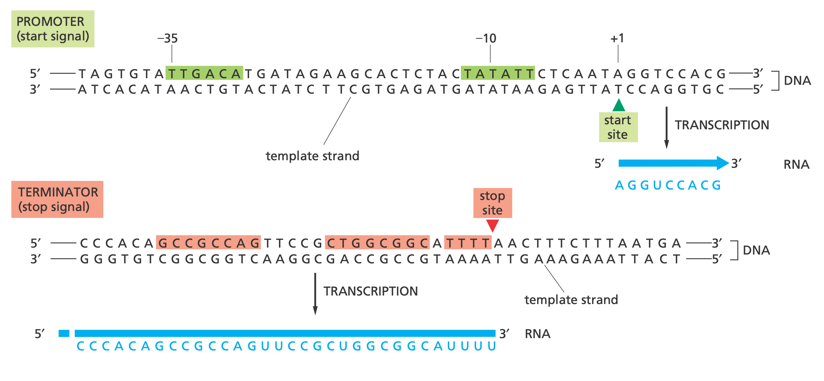
DNA Motifs

Slide 23
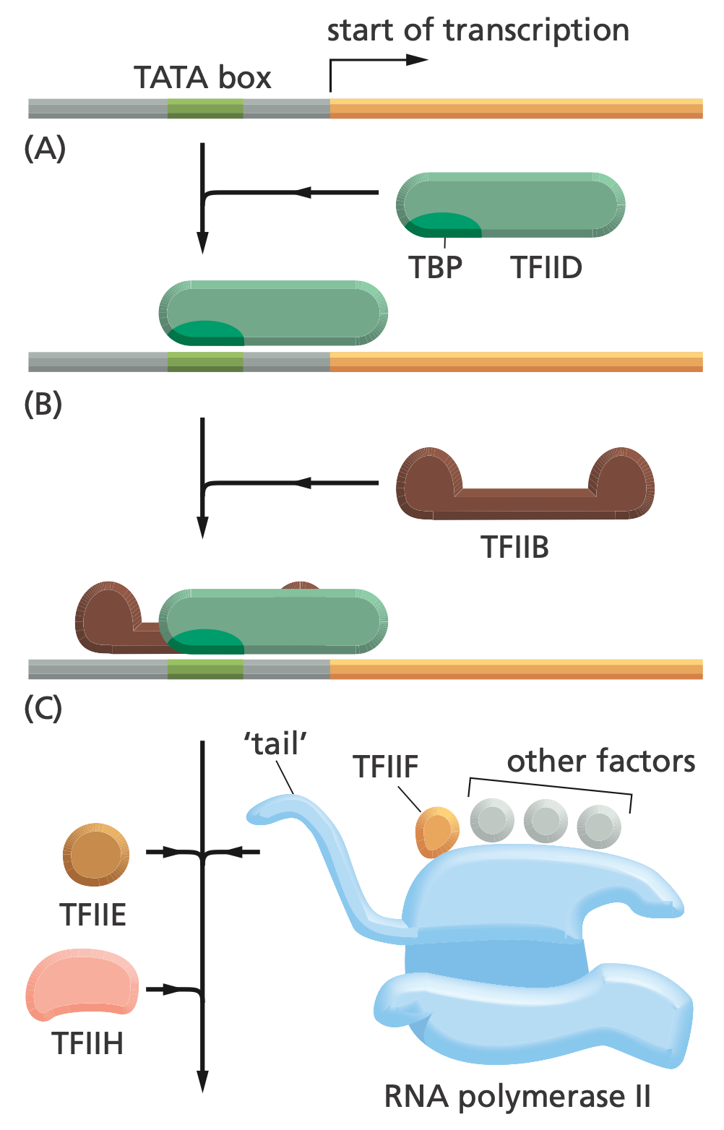
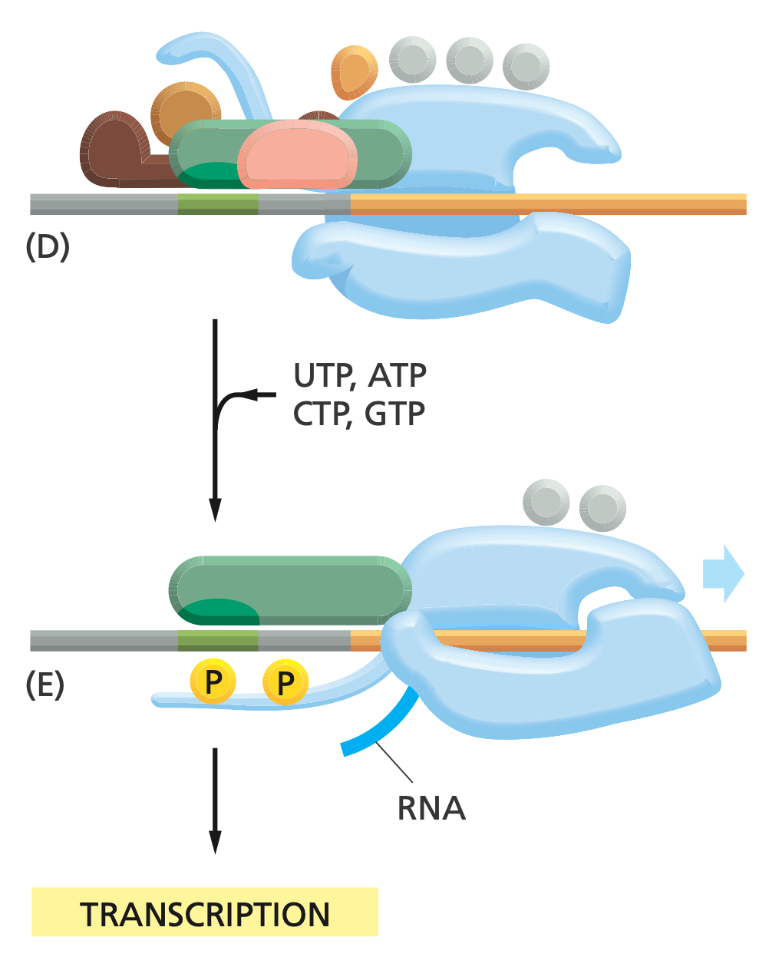
Eukaryotic Transcription
Notes:
TFIIH then pries apart the double helix at the transcription start point, using ATP allowing the template strand to be exposed, and phosphorylates RNA polymerase II, releasing it from the general factors so it can begin the elongation phase of transcription

Slide 24
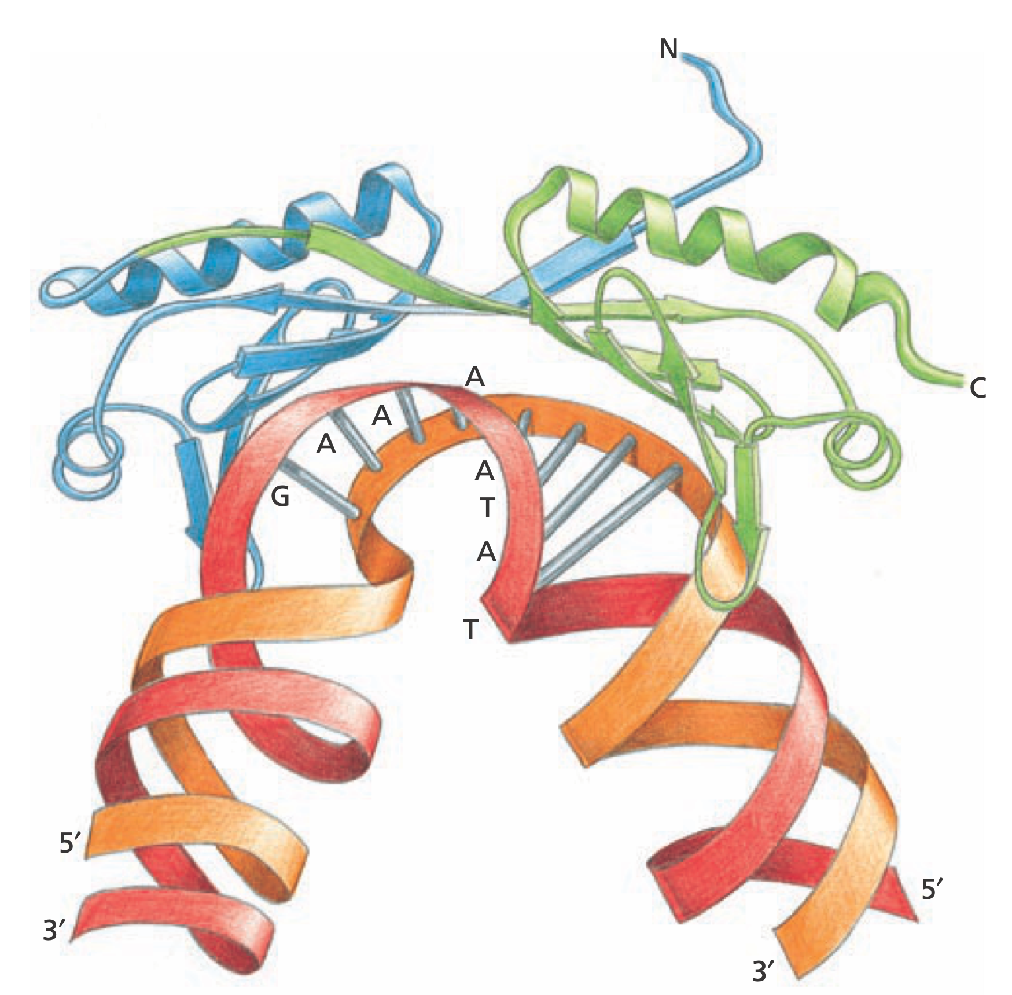
TATA-Binding Protein
Notes:
BP is the subunit of the general transcription factor TFIID that is responsible for recognizing and binding to the TATA box sequence

Slide 25
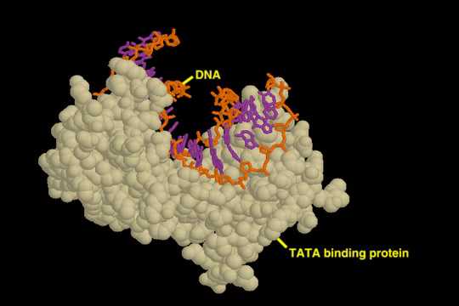
TATA-Binding Protein
Notes:
BP is the subunit of the general transcription factor TFIID that is responsible for recognizing and binding to the TATA box sequence

Slide 26
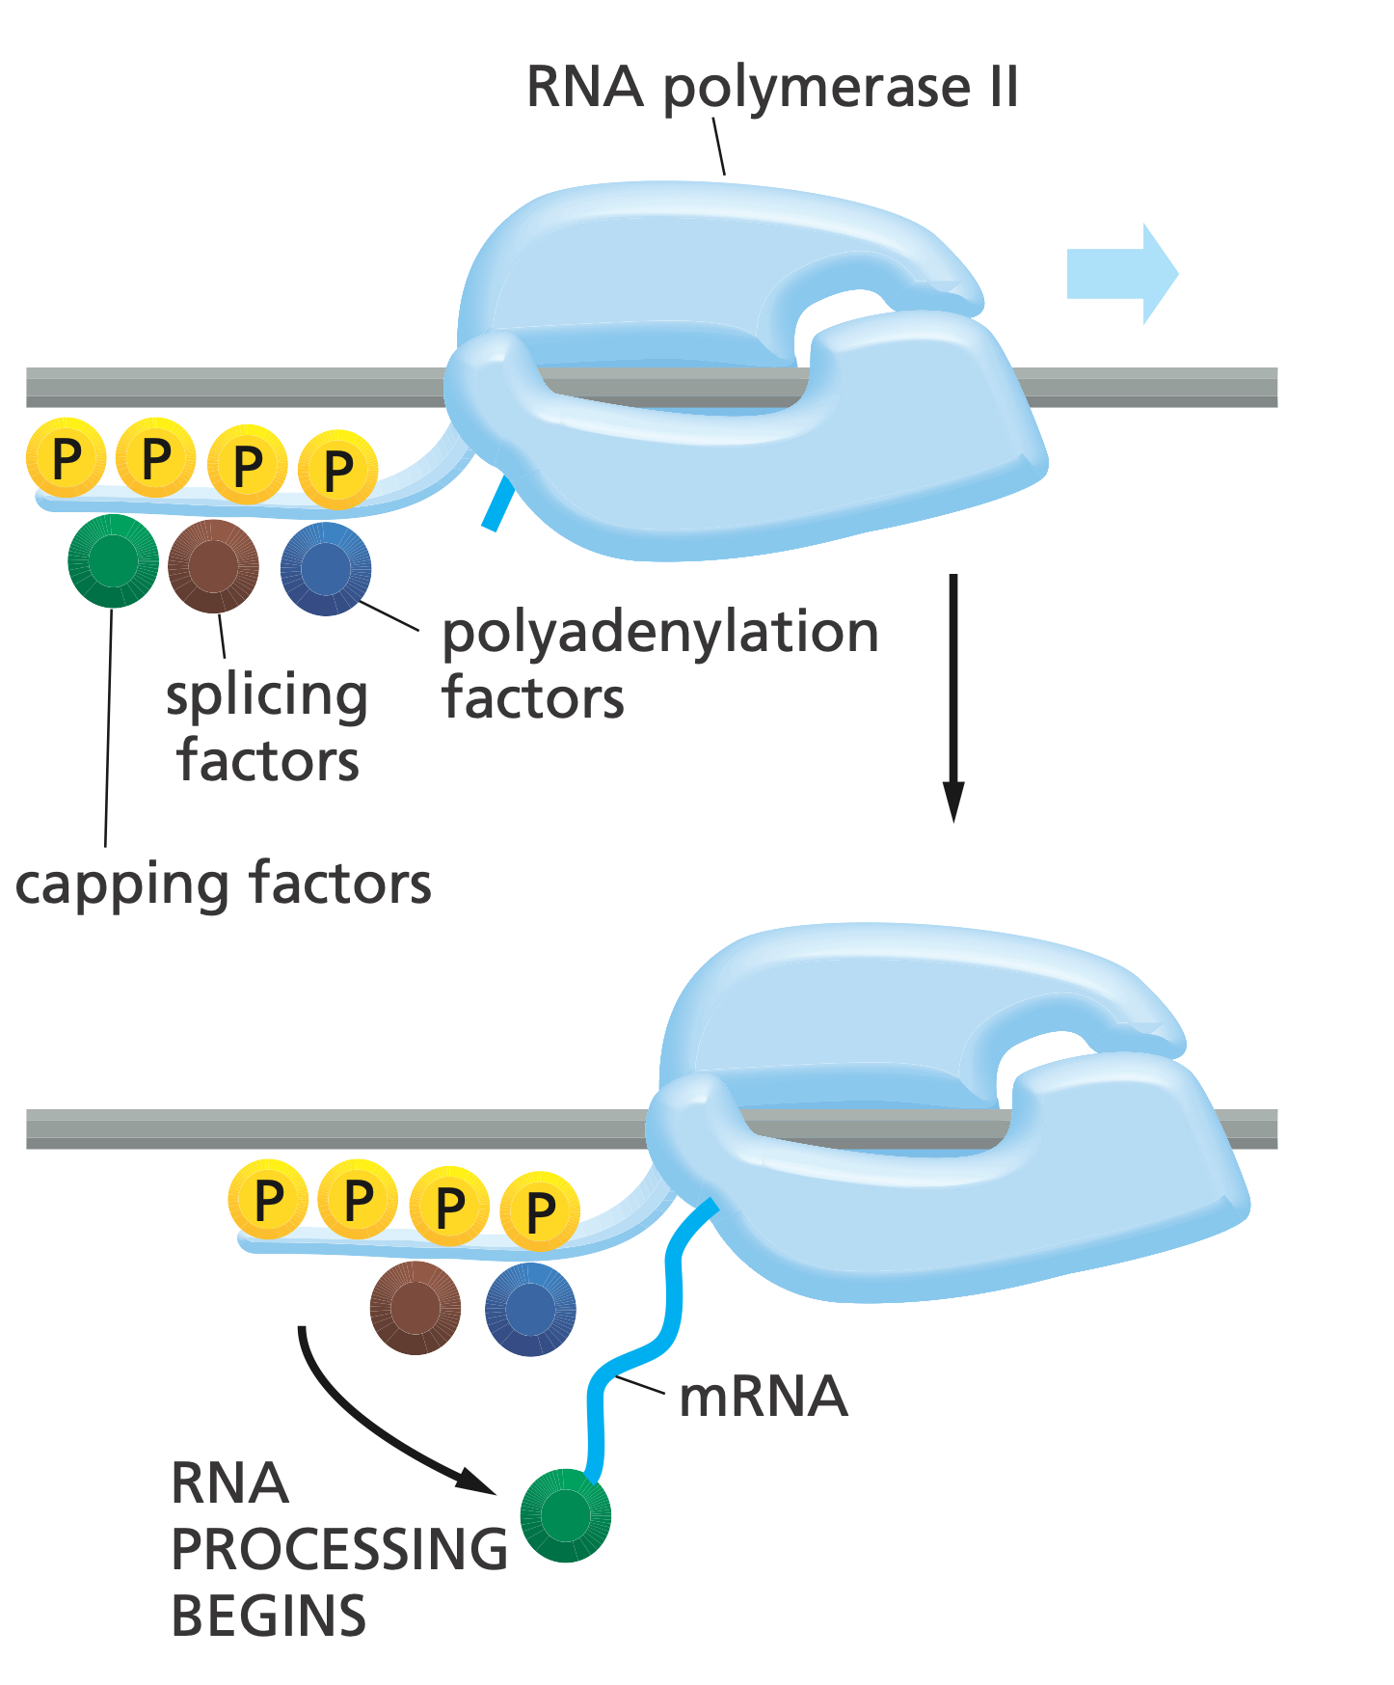
RNA Processing Proteins
Notes:
Not only does the polymerase transcribe DNA into RNA, it also carries RNA-processing proteins that act on the newly made RNA. Some RNA-processing proteins bind to the RNA polymerase tail when it is phosphorylated late in the process of transcription initiation

Slide 27
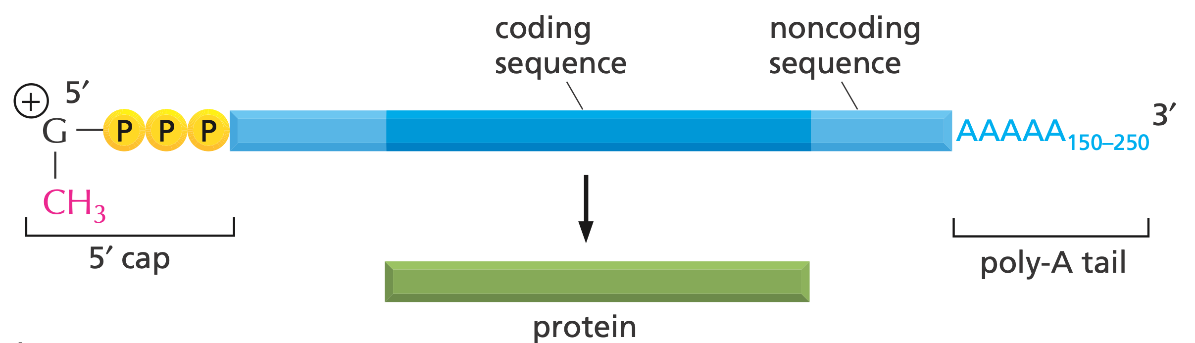
5’-Cap & Poly-A tail

Slide 28
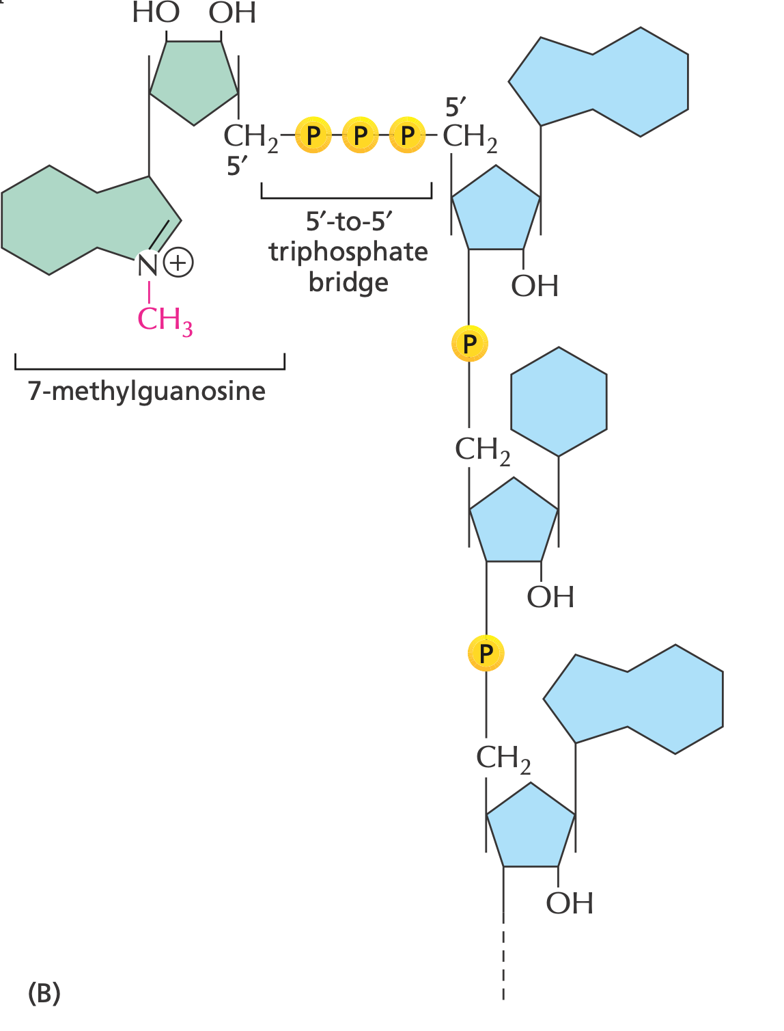
5’ Cap

Slide 29
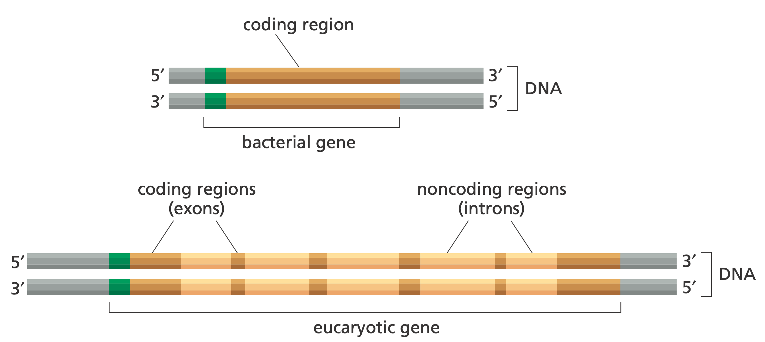
Eukaryotic & Bacterial Genes

Slide 30
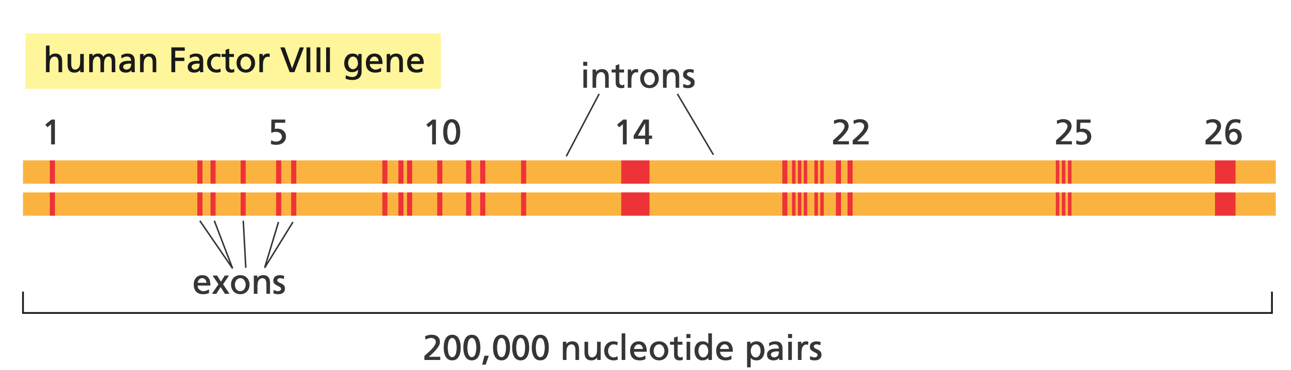
Factor VIII Gene

Slide 31
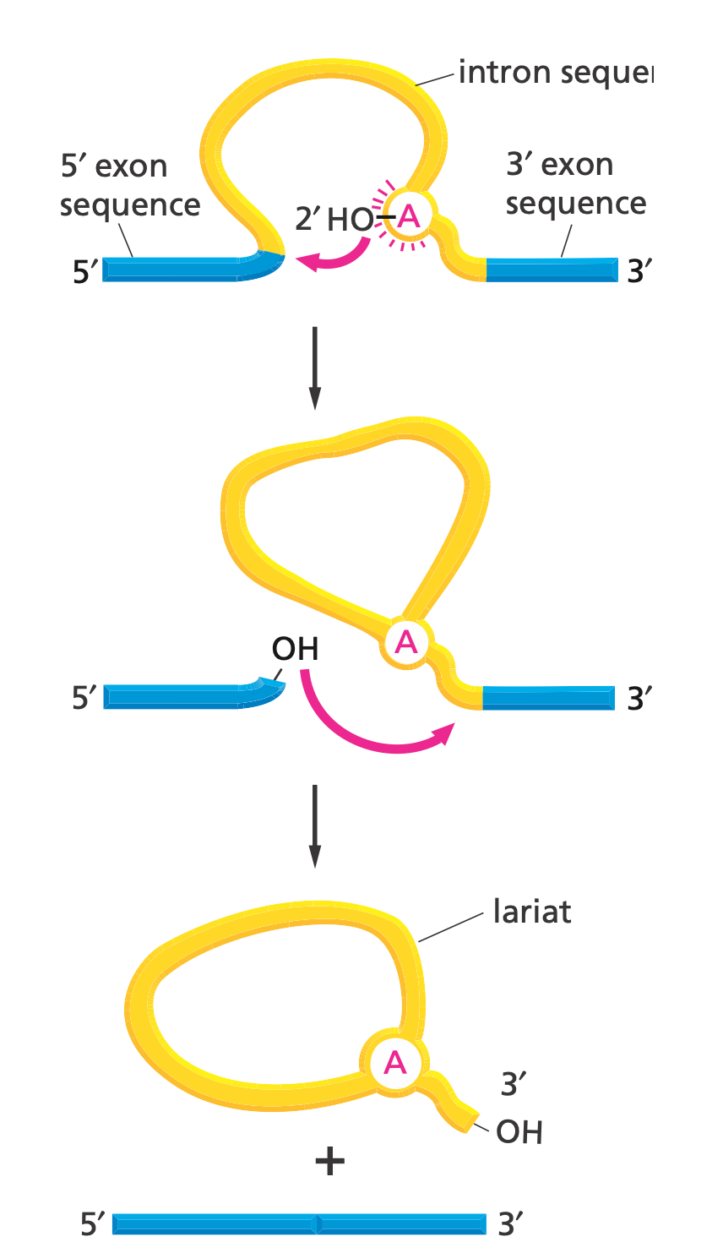
Splicing

Slide 32
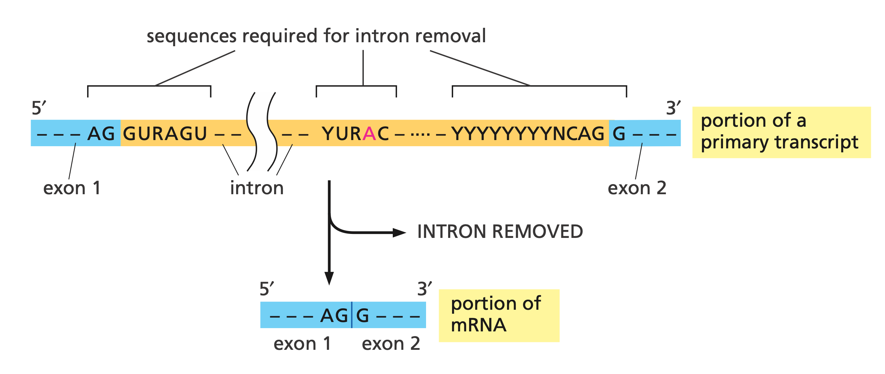
Splicing Motifs

Slide 33
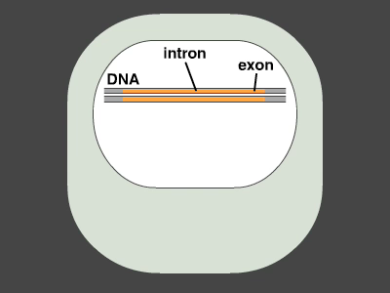
Splicing

Slide 34
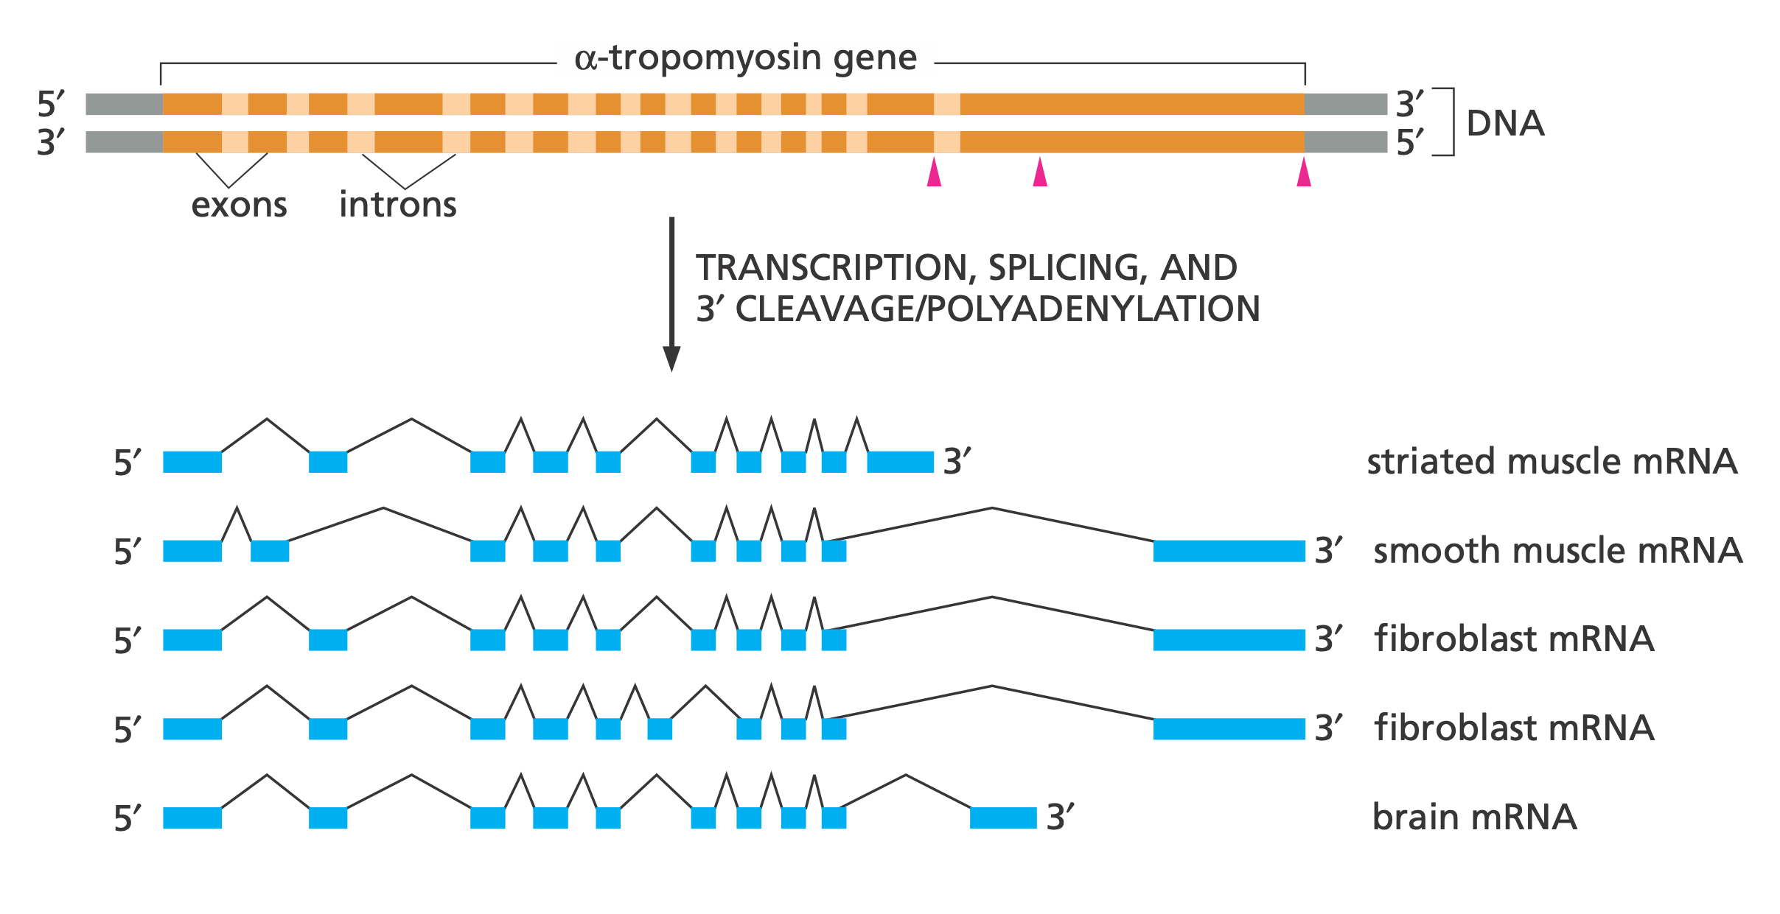
Alternative Splicing
Notes:
alpha-Tropomyosin is a coiled-coil protein that regulates contraction in muscle cells.

Slide 35
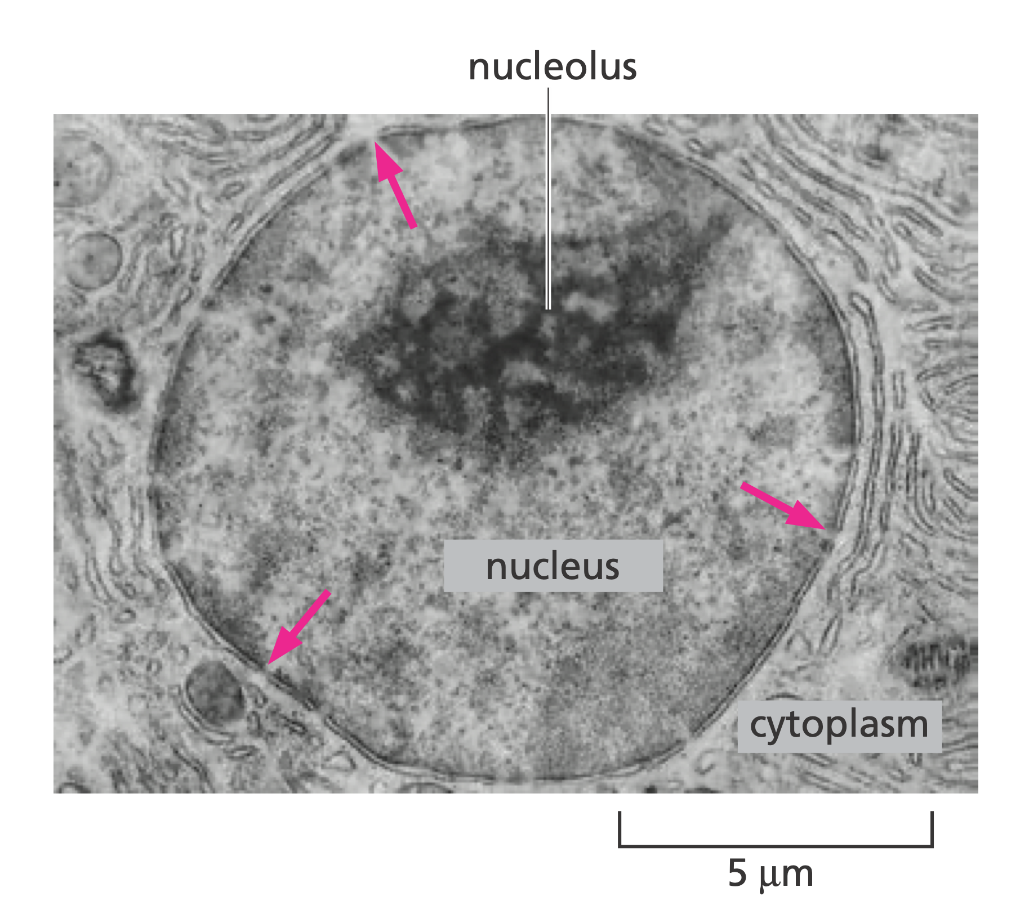
mRNA Export from Nucleus

Slide 36
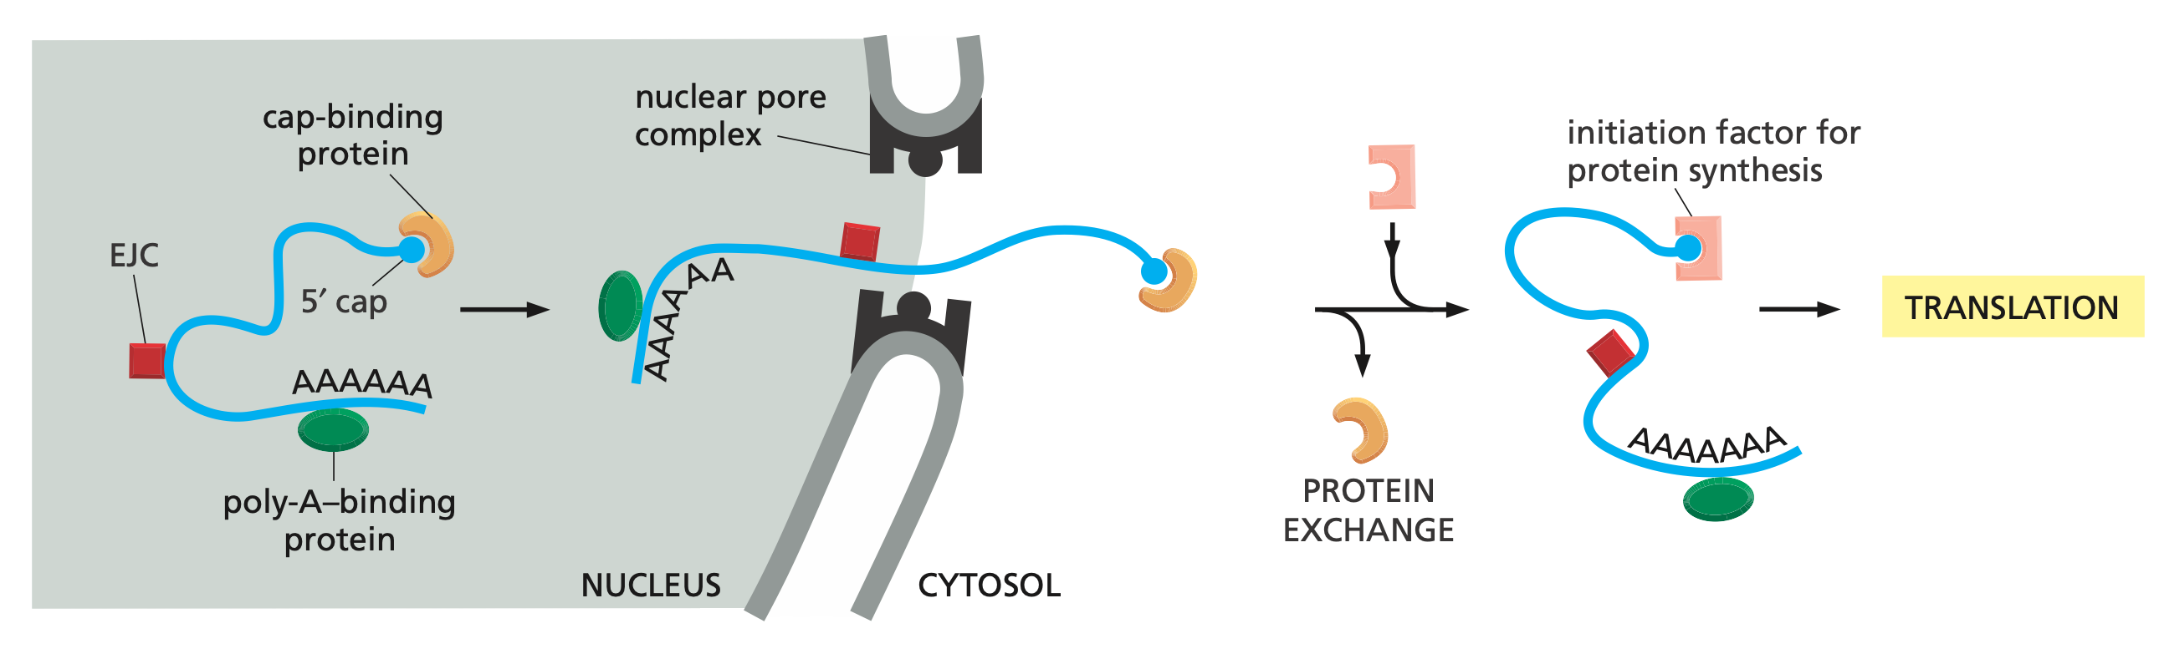
Passport Control!
Notes:
Once the mRNA is deemed ‘export ready,’ a nuclear transport receptor associates with it and guides it through the nuclear pore.

